Slide 1
5 vs 5 Football tactics
November 13th, 2014
Hung Vo - CEO

Slide 2
Why we are always fail?
Individual
Strength
Techniques
Team work
Form
Strategy
Tactics

Slide 3
1 vs 1: basic skills: pass or dribble
2 vs 2:
Teamplay
cooperation
3 vs 3
shape
4 vs 4
Without goal keepers
5 vs 5
With goal keeper
Communication
Changes in available space & opportunities

Slide 4
Diamond form

Slide 5
Diamond form
Each one play half of the field
Save our stamina
Flexible
Clearly define the role

Slide 6
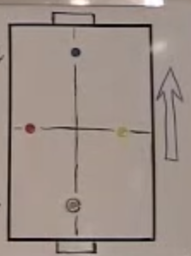
Play in possession
1 penetration
1 support
2 width
Mobility
Improvisation

Slide 7
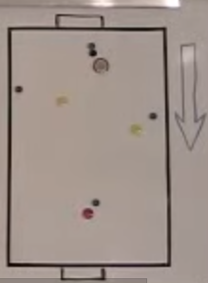
Defense
Pressure
Cover
Balance
Depth
Position of the ball
Position of opponents
Position of teammates
Area of the field
Meaning (state) of the game

Slide 8
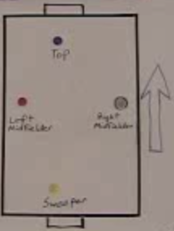
Basic tasks
 | In possession | Opponents in possession
Top | Get or make goals | Disrupt sweeper
Midfield | Support the sweeper | Neutralize opponents
Sweeper | Quality ball up | Neutralize opponent

Slide 9
Conflicts in basic tasks

Slide 10
4 main moments
1 – our team in possession
2 – losing possession
3 – opponents in possession
4 – regaining possession
Open to interpretation

Slide 11
Basic Player Roles and Positions
Roles
1 – Goal scorer
2 – Play maker, who get the ball to the goal scorer
3 – Ball winner
4 – Goal keeper
Position
Center
Left
Right
Ahead of the ball
Behind the ball

Slide 12
References
https://www.youtube.com/playlist?list=PL4649287D1D40E872
https://www.youtube.com/playlist?list=PLCCFC8720E0DE3127

