Slide 1
Text Classification using Machine Learning
Student: Hung Vo
Course: CP-SC 881
Instructor: Professor Luo Feng
Clemson University
04/27/2011

Slide 2
Text classification

Slide 3
Applications

Slide 4
Applications
Topic spotting
Email routing,
Language guessing,
Webpage Type Classification,
A Product Review Classification Task,
…

Slide 5
Methods
Naive Bayes classifier
Tf-idf
Latent semantic indexing
Support vector machines (SVM)
Artificial neural network
kNN
Secision trees, such as ID3 or C4.5
Concept Mining
Rough set based classifier
Soft set based classifier
20 topics,
~1000 documents each
74.49% correct

Slide 6
Project
Build Naïve Bayes classifier from scratch
MS Visual C# 2008
MS .Net Framework 3.5

Slide 7
Data set
Training Data
Test Data

Slide 8
Approach
Training Data
Learning
Algorithm
ID | Att1 | Att2 | Cat
1 | Yes | 0.5 | A
…
N | No | 0.7 | B
Learn
Model
Model
Model
Model
Test Data
Test Data
ID | Att1 | Att2 | Cat
1 | No | 0.8 | B
…
M | Yes | 0.2 | A
Apply
Model
ID | Att1 | Att2 | Cat
1 | No | 0.8 | ?
…
M | Yes | 0.2 | ?

Slide 9
Model
Based on words
Probability of words in document/category
Need to extract important words first, then build parameters

Slide 10
Building Model
Tokenize
Remove stop words
Stemmer
Calculate parameters

Slide 11
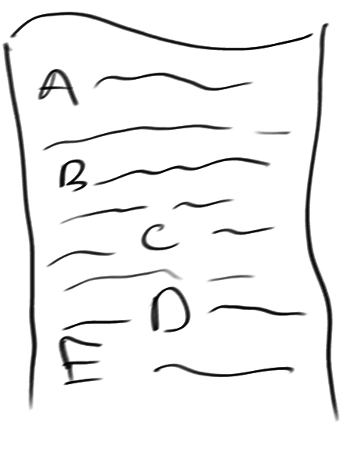
Tokenize
Collect all data in one categories

Slide 12
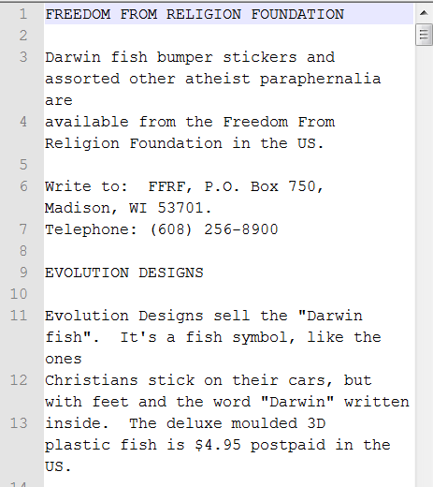
Tokenize
All text in a Category
Tokenized result

Slide 13
Remove Stop Words
Stop words
High frequency
Appear almost documents
Least important
Stop words removed

Slide 14
Stemmer
Stemmed tokens
Remove prefix, suffix
Return the base, root or stem of words

Slide 15
Vocabulary and frequency
Sort
Count
Vocabulary of first category

Slide 16
Remove low frequency tokens
Drop tokens/terms appear less than threshold
Chosen threshold: 10
69604 -> 12881
Faster processing

Slide 17
Calculate parameters
Model
D Set of documents
N = #d(D)
V Set of vocabulary/tokens/terms
C set of Categories
For each category c in C
N_{c} Number of documents
Prior = N_{c}/N
text_{c} All text in category c
return V,prior, condprob
foreach t in V
do T_{ct}= countTokens(t,text_{c})
foreach t in V
$$condprob\left[t,c\right]= \frac{Tct+1}{Σt′(Tct^{′}+1)}$$

Slide 18
Apply model for text classification
Need: C,V,prior, condprob, d
d document to be classified
W extracted tokens from (V,d)
foreach c in C
do score[c] = log(prior[c])
foreach t in W
do score[c] += log(condprob[t,c])
return argmax_{c in C}(score[c])

Slide 19
Result
74.49%
Near topic

Slide 20
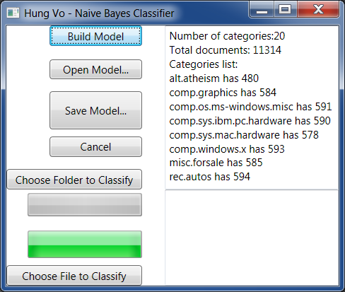
Demo

Slide 21
Future Works
More methods
Compare them
Build different models
Threshold
Word phrase

Slide 22
Thank you

